Slide 1

CEIS 110
Final Project
Programming with Data
Ashley Bravo
Professor Schneider
May 2024 Session
June 22, 2024

Slide 2
Introduction
In this project we used a cloud-based system to gather and analyze temperature and humidity data.
We utilized Python to complete this project, either Replit or Anaconda.

Slide 3
Module 2
Design and setup

Slide 4
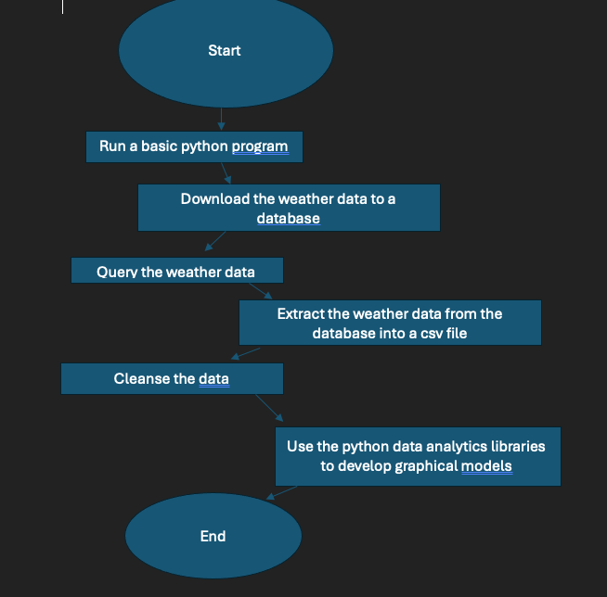
Flowchart
Include the following processes:
  Run a basic python program
  Download weather data to a database.
  Query the weather data
  Extract weather data from database into a comma separated file with python
  Cleanse weather data
  Use python data analytics modules to develop graphical models

Slide 5
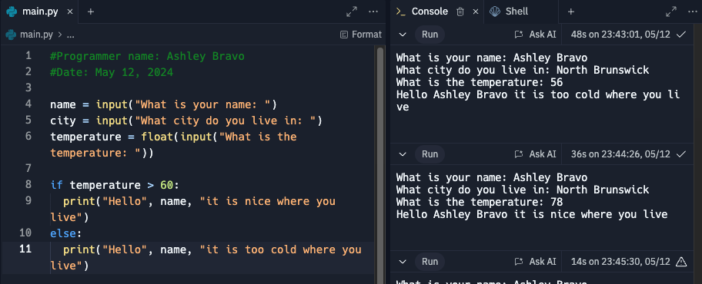
Python program
Include screenshot of successful python program

Slide 6
Module 3
Downloading weather data

Slide 7
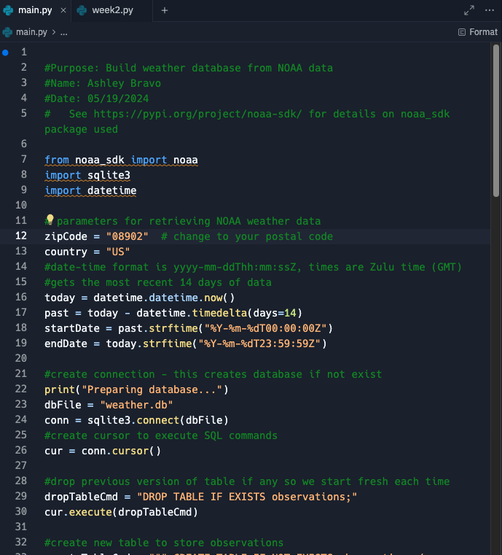
Build WeatherDb.py Code
Screenshot of code in Spyder
Must have your name and date in comments
Must have your zip code

Slide 8
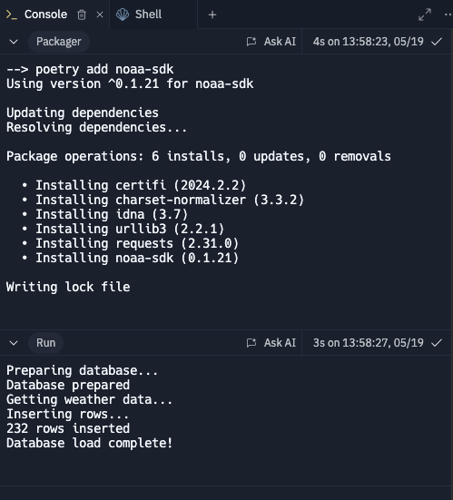
Python Console
Screenshot of program output in Python console showing program executed successfully

Slide 9
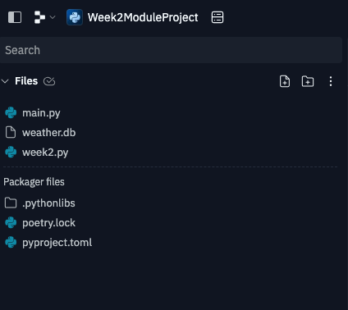
Weather.db File
Screenshot of Windows Explorer showing database file Weather.db was created

Slide 10
Module 4
Querying the database with SQL

Slide 11
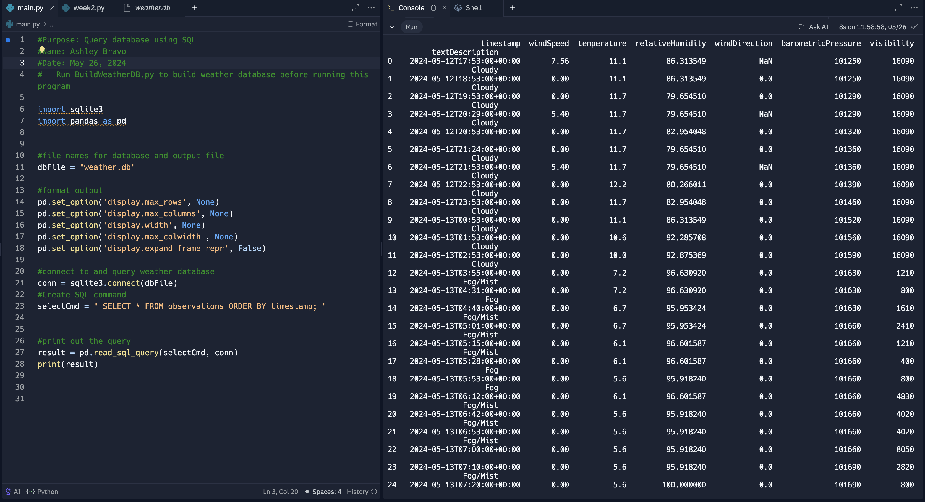
Query to retrieve all columns and all rows
Screenshot of SQL query command and results

Slide 12
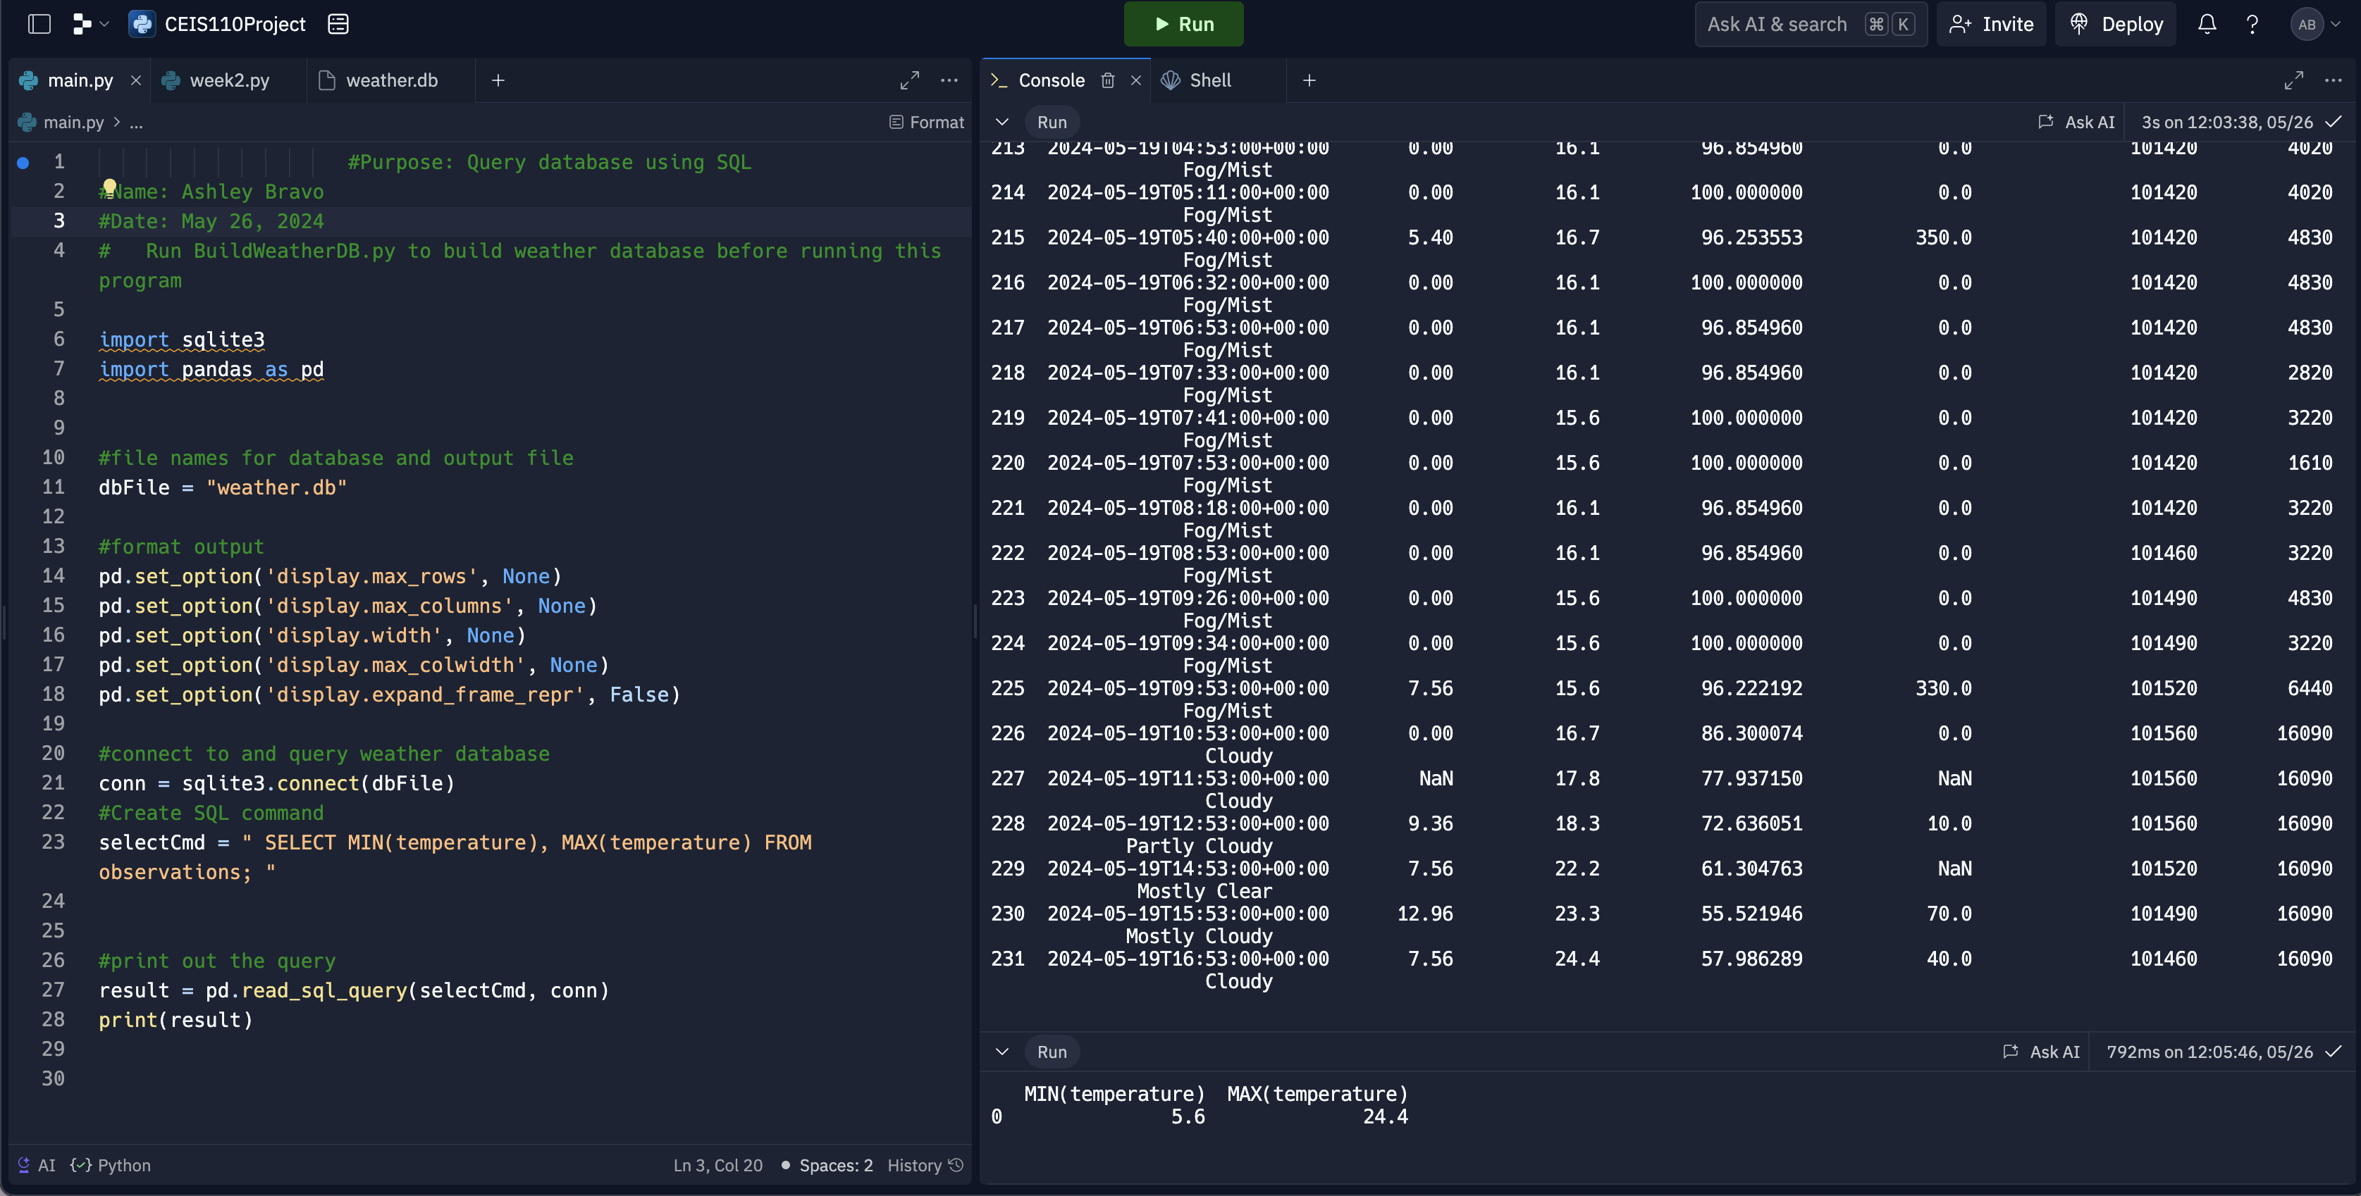
Query to retrieve lowest and highest temperatures
Screenshot of SQL query command and results

Slide 13
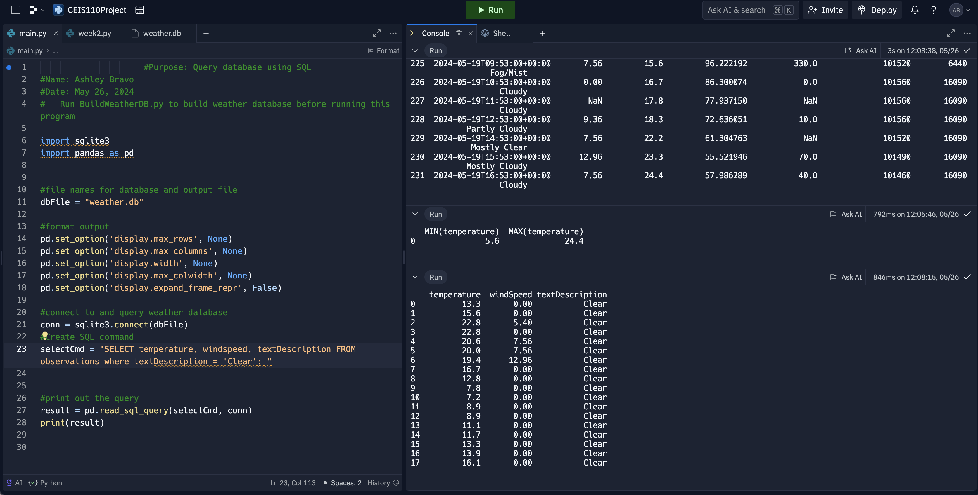
Query to retrieve all clear days
Screenshot of SQL query command and results

Slide 14
Module 5
Querying and manipulating data with SQL and Python

Slide 15
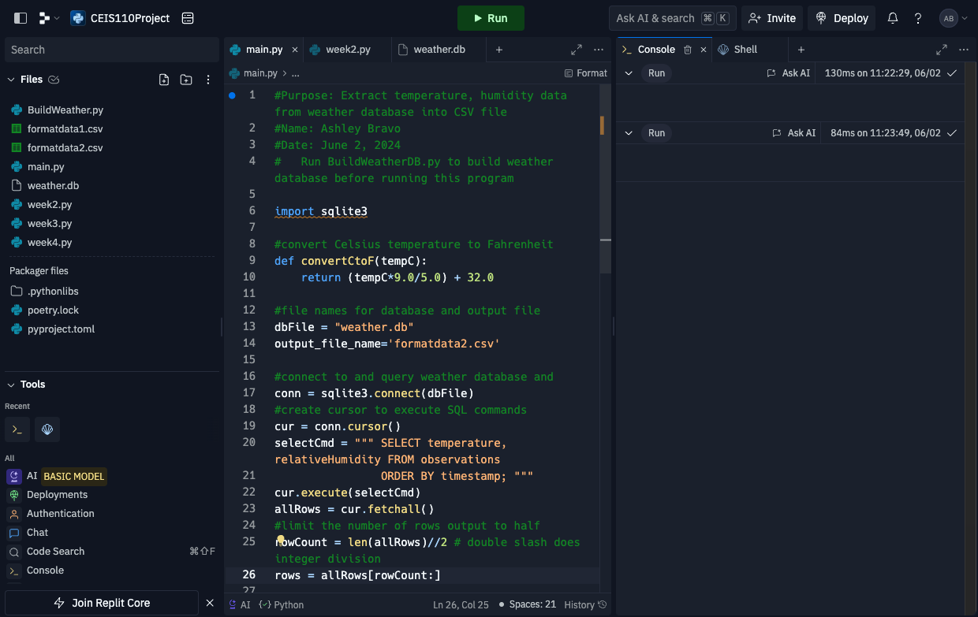
Python code
Extract TempHumidity.py Python code with your name and date in comments

Slide 16
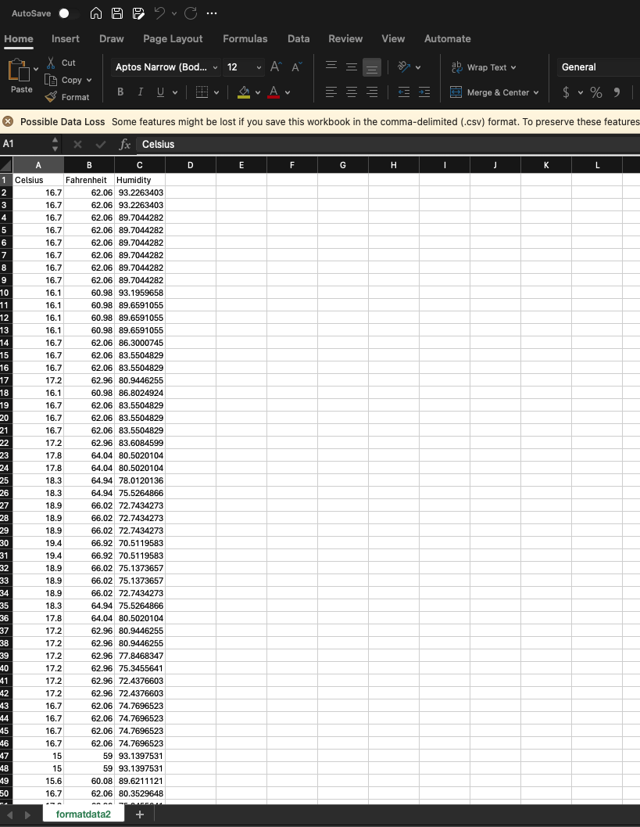
Retrieve and Convert Data to CSV Format
Format data file open in Excel showing 3 columns of data

Slide 17
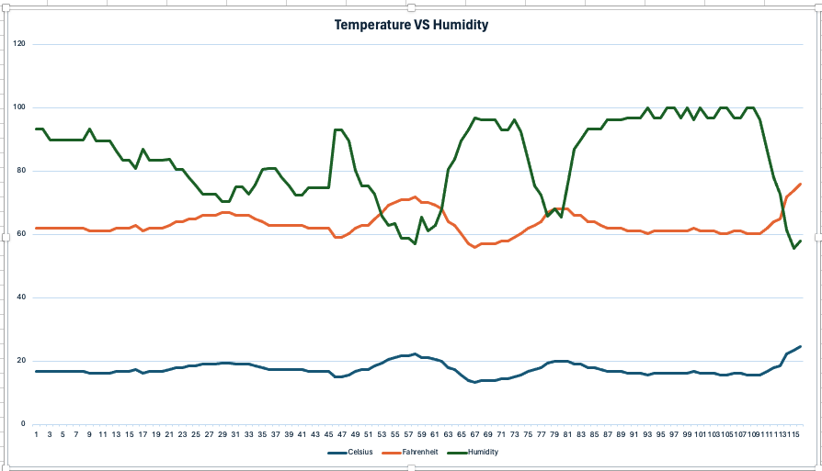
Temperature and Humidity Chart
Excel chart based on temperature and humidity data from database

Slide 18
Module 6
Develop Graphical Models and Interpret Results

Slide 19
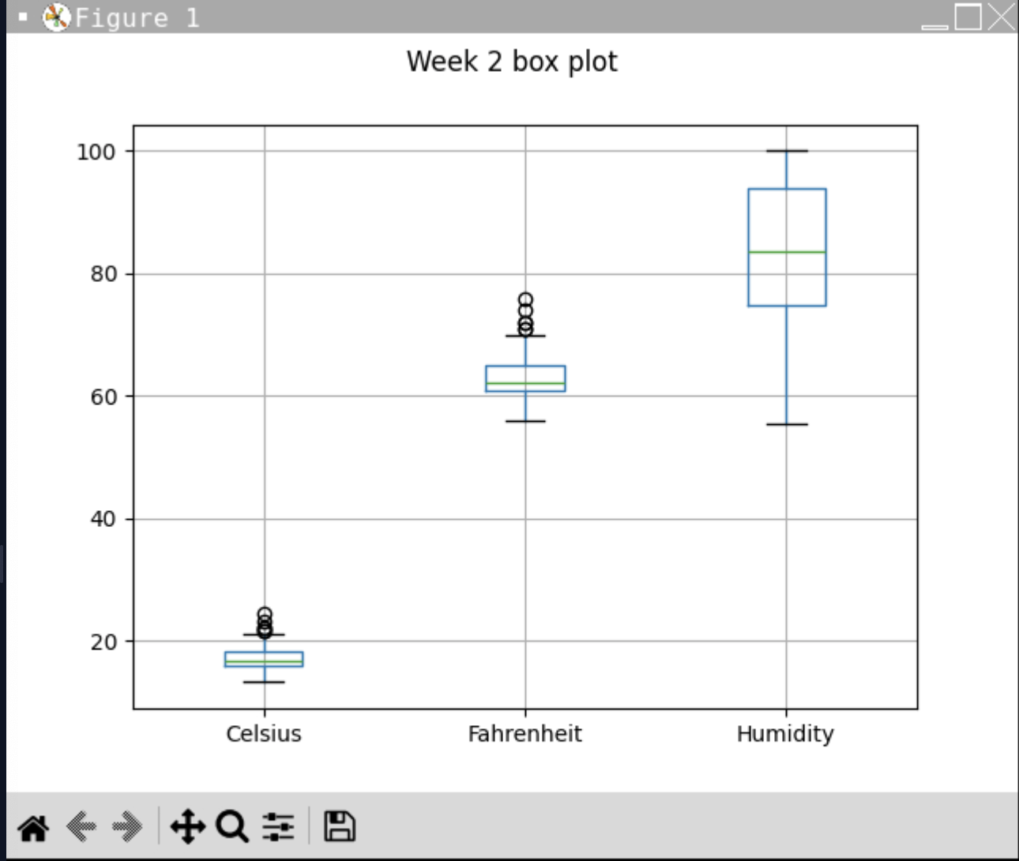
Plot #1
Plot and code used to generate it
Box
Line
Histogram
Scatter
Research your own!

Slide 20
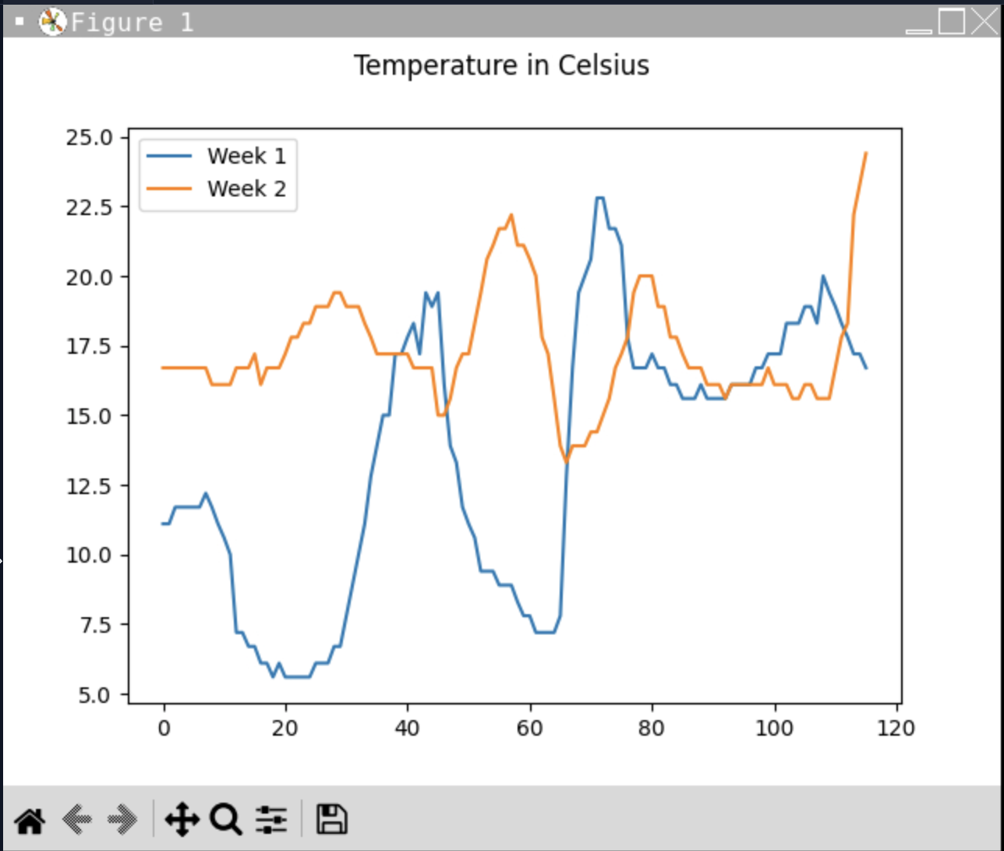
Plot #2
Plot and code used to generate it
Box
Line
Histogram
Scatter
Research your own!

Slide 21
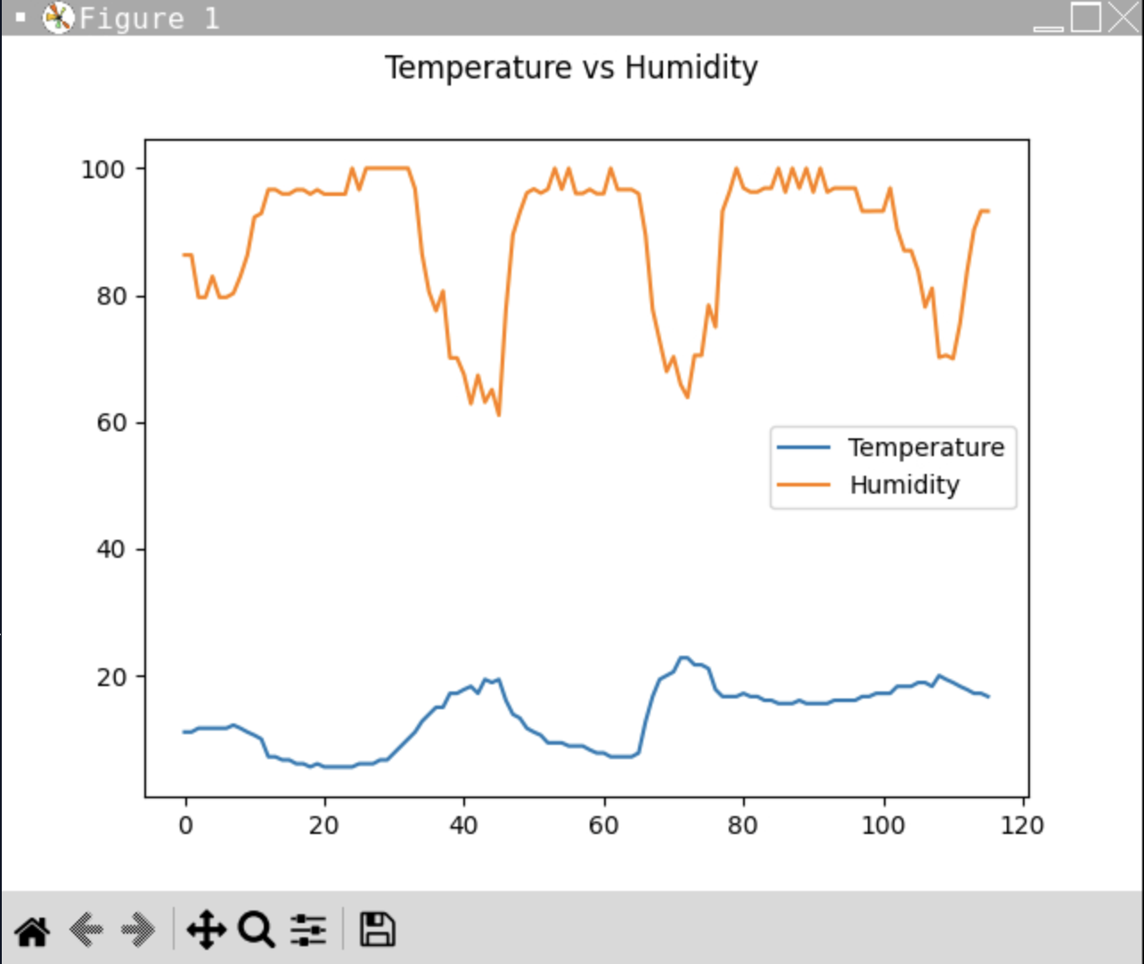
Analysis
Think of your own question and create a chart/graph to answer it
Your own question: Is there a relationship between temperature and humidity?
Answer supported by Chart: There are opposite results between temperature and humidity.

Slide 22
Prediction
Develop a prediction based on the data. What variations in temperature and humidity do you expect over the next few hours or days? How would humidity change if temperature goes up or down?
I predict that as the temperature rises there will be a decrease in humidity. As we see on the chart it shows opposite results.

Slide 23
Challenges
Challenges I faced during the process of this project were making sure the code was properly uploaded with no misspelling or the program wouldn’t run smoothly.
I also had some small issues with creating charts of the data on excel.

Slide 24
Career Skills
Database development
Programming using Python
Troubleshooting errors in code
Analyzing the data to create charts

Slide 25
Conclusion
This project was a great introduction to the programming world and use of Python and cloud-based systems to perform data analytics.

Slide 26
Wix.com
https://bravoash25.wixsite.com/my-site

