Slide 1


SEC285 Final Project
Ashley Bravo
Professor Mustafa
DeVry University
September 2024 Session

Slide 2
Introduction
In this course, I learned to :
Describe different types of malware.
Identify social engineering attacks.
Differentiate cryptographic algorithms and their applications.
Survey network security devices and protocols.
Explain wireless network security solutions.
Interpret application security, device security, and physical security.
Examine authentication and access control techniques.
Assess business continuity and risk management strategies.
Explore the evolving job market in the digitized world.
Produce a secure network.

Slide 3
Module 2
Asymmetric Key Encryption

Slide 4
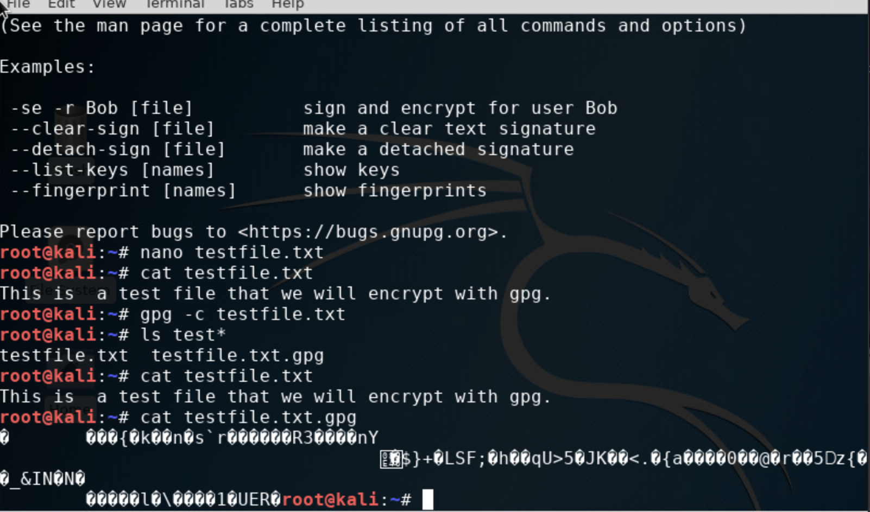
File Encryption
This screenshot should show the following.
Content of the plaintext file
Content of the encrypted file

Slide 5
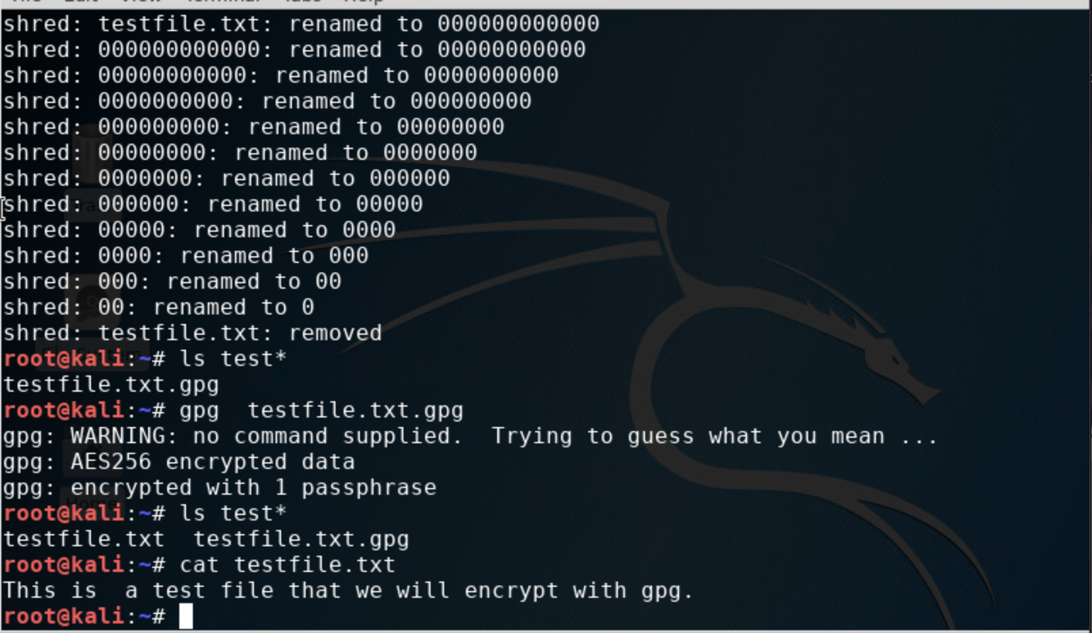
File Decryption
This screenshot should show the following.
The encrypted file being listed by itself
The decrypting process
Both the encrypted file and the original plaintext file being listed

Slide 6
Module 3
Stateful Firewall

Slide 7
What effect does the sudo iptables --policy INPUT DROP command have on the access to computing resources?
By dropping all unwanted connections, the server is even more protected from unverified access, which reduces the risk of future attacks.

Slide 8
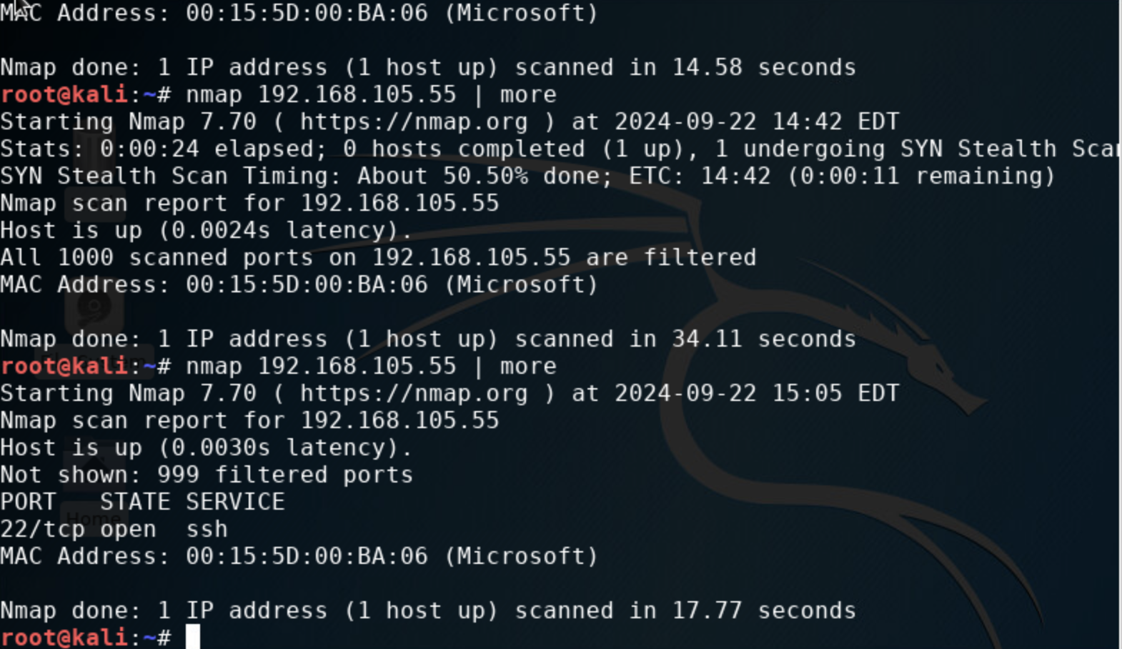
Nmap Scan
This screenshot should show the Nmap scan result of the Linux Server VM.

Slide 9
Module 4
Bring Your Own Device (BYOD)
Security Policy

Slide 10
1. Overview:
In the day and age tablets, smartphones and laptops have become tools, for the functioning of contemporary businesses. These devices are favored by workers for their convenience and portability allowing them to access resources remotely and enhancing productivity. However the use of tools also poses security threats like data breaches, access, to systems and malware attacks. It is imperative to address these risks to protect the company's data.
2. Purpose:
The main goal of the Bring Your Device (BYOD) security policy is to protect the confidentiality and integrity of data accessed through devices while ensuring its availability (CIA). By recognizing and controlling devices that could pose security risks and vulnerabilities, to the system, in advance helps the company prevent security threats effectively and promptly address any issues that may arise in this regard.

Slide 11
3. Scope:
This guideline is for everyone working at ABC Corporation. Employees and contractors alike. Third-party users use their devices, like smartphones and laptops, to access the company's networks and resources.
4. Policy:
Employees at ABC Corporation are allowed to use their devices for work purposes as long as they adhere to defined security measures in place. Every personal device must comply with the security criteria, which include the following requirements;
Operating systems that are regularly. Equipped with the security patches are essential for maintaining a secure digital environment.
Ensure your device is protected with antivirus and anti-malware security measures in place.
Securing access with a password. Using verification for authentication purposes.
Securing information through encryption methods for data storage.
Employees should promptly notify the IT department in case of any stolen devices.

Slide 12
5. Policy Compliance:
The Information Security team will ensure compliance, with this policy through activities such as audits and monitoring access permissions carefully while also staying vigilant about any incidents that occur.If staff members fail to adhere to the BYOD security guidelines they could face consequences such, as losing their privileges or even risking termination of employment.
6. Related Standards, Policies, and Processes:
HIPAA safeguards patient data, within healthcare environments.
Maintains the safety of credit card transactions and information by following PCI DSS guidelines.
Company Data Protection Policy details guidelines, for managing and safeguarding data.

Slide 13
7. Definitions and Terms:
BYOD, short, for Bring Your Device refers to a policy that permits employees to utilize their gadgets for tasks related to their work responsibilities.
Mobile gadgets such, as smartphones and tablets are commonly used to access company resources on the go.
The CIA model. Which stands for Confidentiality, Integrity and Availability. Is a framework created to shape information security policies in a company or organization.
8. Revision History:
Date of change | Responsible | Summary of change
September 2024 | SANS policy team | Updated and converted to new format

Slide 14
Module 5
Multifactor Authentication (MFA)

Slide 15
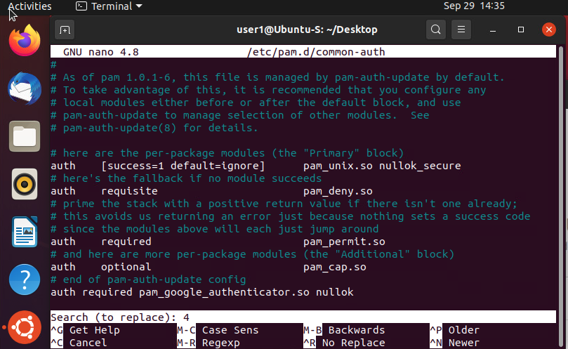
Common-auth Configuration File
This screenshot should show the entry that indicates the use of the Google Authenticator module.

Slide 16
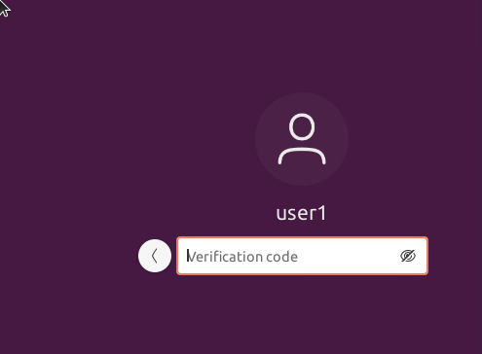
MFA Logon Screen
This screenshot should show the logon screen where a verification code is required.

Slide 17
Module 6
Vulnerability Assessment

Slide 18
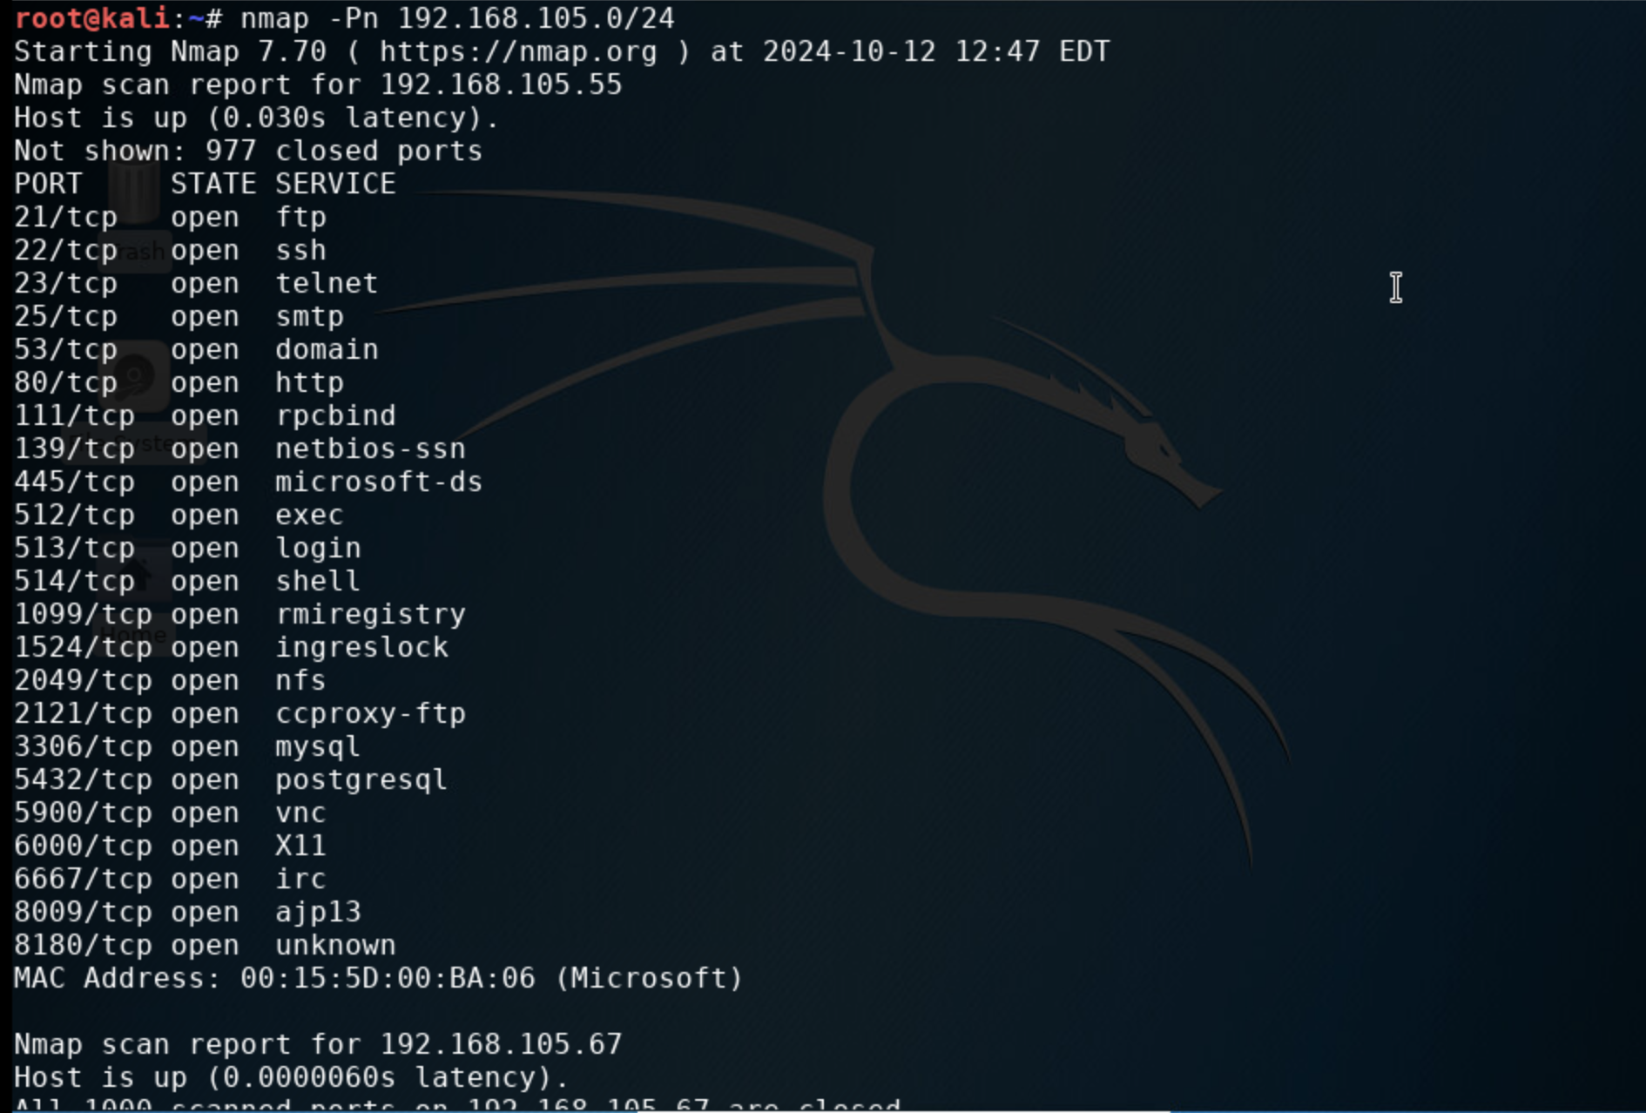
Nmap
This screenshot should include the scan result showing both the Kali and Linux Server VMs.

Slide 19
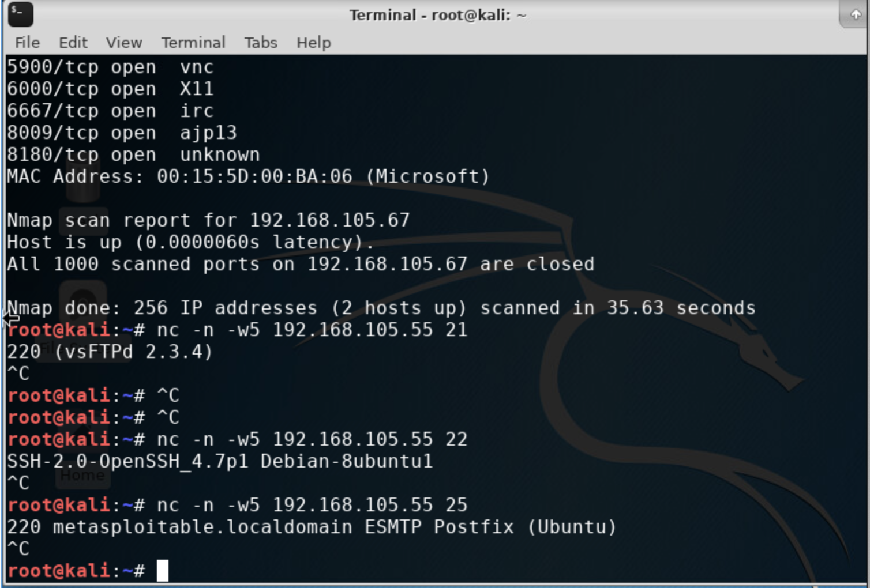
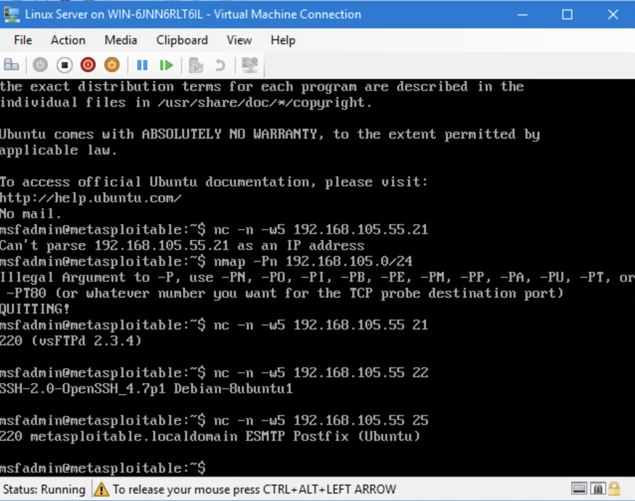
NetCat
This screenshot should include the scan result showing both the Kali and Linux Server VMs.

Slide 20
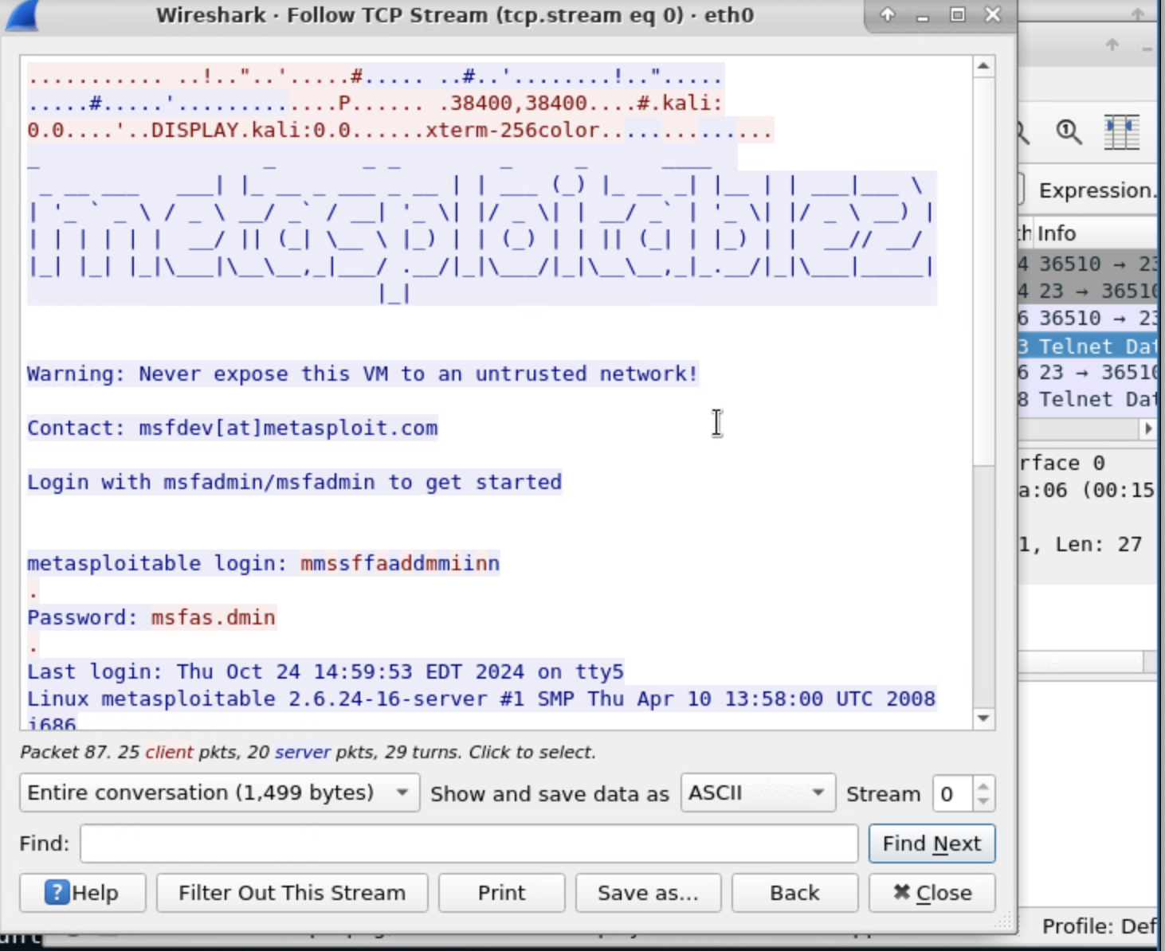
Wireshark
This screenshot should include the Wireshark—Follow TCP Steam window showing the Telnet username and password.

Slide 21
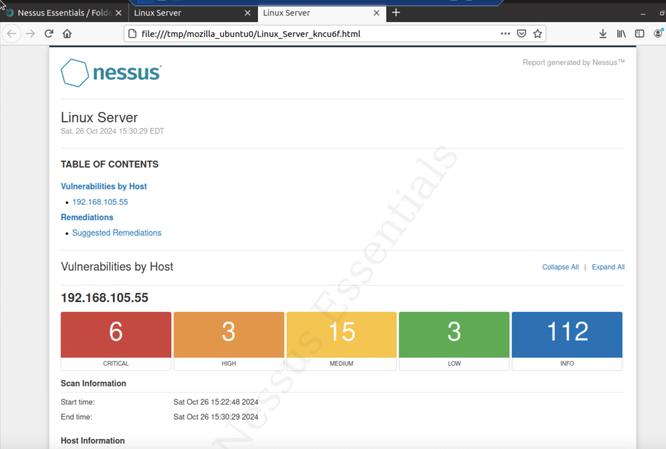
Nessus
This screenshot should include the high-level view of the Nessus vulnerability scan report (showing categories of vulnerability in different colors).

Slide 22
Challenges
I had some challenges with coming up with my own security policy. I did some research, and I eventually got it figured out.
Module 6 project was also challenging for me at times. I did not understand how to properly display the NetCat for both Linux and Kali. I reworked the program a few times, and I eventually got it figured out, and the remainder of the project went smoothly.

Slide 23
Career Skills
Risk Assessment
Threat Analysis
Incident Response
Network Security

Slide 24
Conclusion
In conclusion, this course taught me the basics of maintaining the safety of PII and computer systems from threats.
Fundamentals of Information System Security Fundamentals of Information System Security course addresses network security and data protection.

Slide 25
Wix.com
https://bravoash25.wixsite.com/my-site

