Slide 1

Introduction to Operating Systems
CEIS106 Final Course Project
MARCH 2024
Ashley Bravo
Professor TURKEY

Slide 2
Linux Filesystem Hierarchy
Learn how to navigate the Linux filesystem tree.
Create directories and files.
Copy and remove directories and files.
Locate directories and files.

Slide 3
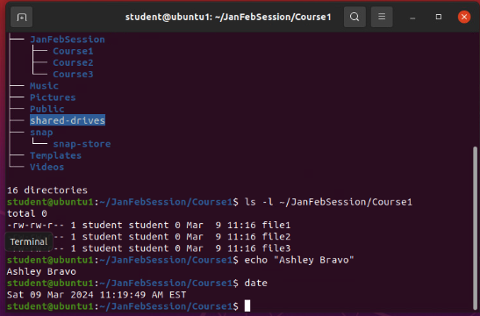
Create Directories and Files

Slide 4
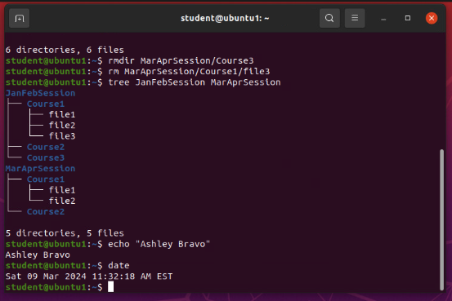
Copy and Remove Directories and Files

Slide 5
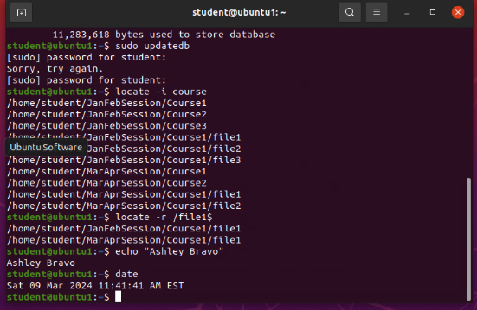
Locate Directories and Files

Slide 6

Linux Shell Scripts
Create a shell script.
Change script file permissions.
Set the PATH variable.
Make the PATH variable permanent.

Slide 7
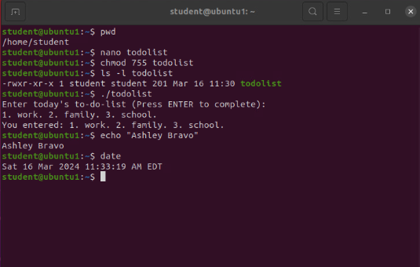
Change Script File Permissions

Slide 8
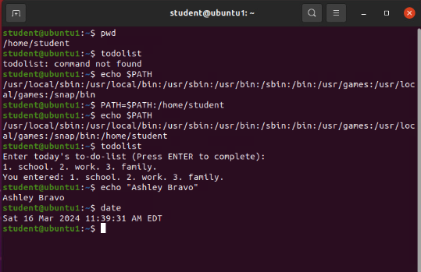
Set the PATH Variable

Slide 9
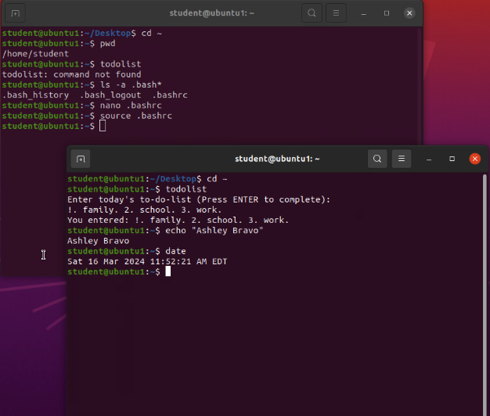
Make the PATH variable permanent
Run the todolist script before and after making the PATH variable permanent. Take a screenshot of both Terminal windows.

Slide 10

User and Group Management
Add users and groups in CLI.
Test user and group settings.
Add users in GUI.
Remove users and groups.

Slide 11
Add users and groups in CLI
-m –tells the useradd command to create a home directory for this new user
-3. --tells tail command to show the last 3 lines of the file
This line of the /etc/group file lists members of the “students” group

Slide 12
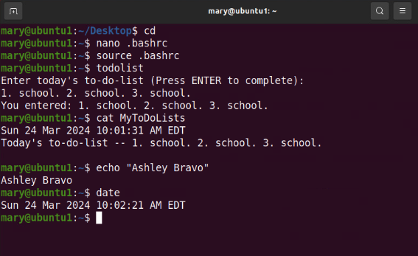
Test User and Group Settings

Slide 13
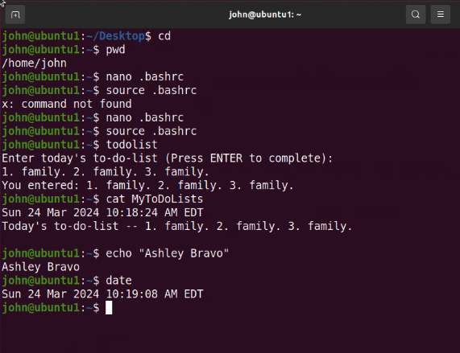
Add Users in GUI

Slide 14
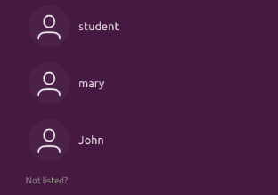
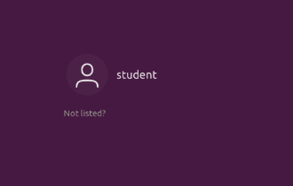
Remove Users and Groups

Slide 15

Network Configuration
Discover host IP configurations.
Manage network interfaces.
Use network utilities.

Slide 16
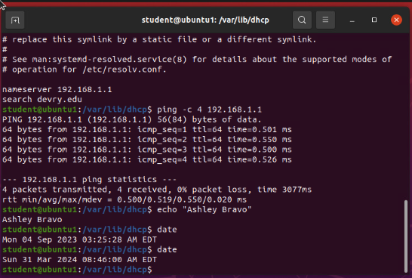
Discover host IP configurations
What is the IP address of your Ubuntu machine?
192.168.1.107
What is the IP address of its default gateway?
192.168.1.1
What is the IP address of its DHCP server?
192.168.1.1
What is the IP address of its DNS server?
192.168.1.1

Slide 17
Manage network interfaces
Which DHCP message is shown in the output of the sudo dhclient –v –r ens33 command?
DHCPRELEASE
Which four DHCP messages are shown in the output of the sudo dhclient –v ens33 command?
DHCPDISCOVER
DHCPOFFER
DHCPREQUEST
DHCPPACK

Slide 18
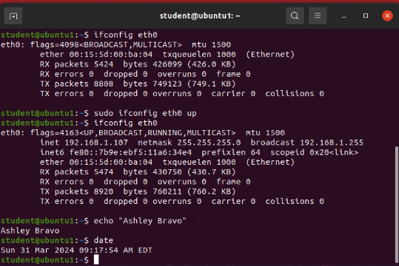
Use Network Utilities

Slide 19
System Performance Monitoring
Monitor Linux processes.
Monitor user activities.
Monitor network bandwidth usage.

Slide 20
Monitor Linux processes
What is the default action of the 15 SIGTERM kill signal?
The default action is to kill the highlighted process.
In the System Monitor window, click on % CPU to sort the processes by CPU load.
Which process shows the highest percentage of CPU usage?
Gnome-shell (GUI)

Slide 21
Monitor user activities
Issue the sudo accton on command to turn on GNC accounting. Run the sudo updatedb command. Enter lastcomm updatedb to check if the updatedb command was executed before. Remember to turn off GNC accounting (sudo accton off) after answering the questions.
What flag value is displayed in the output?
S – “super user”
Why is the name of the user who ran the processes shown as root, not student?
Superuser—since we typed sudo in front of the command

Slide 22
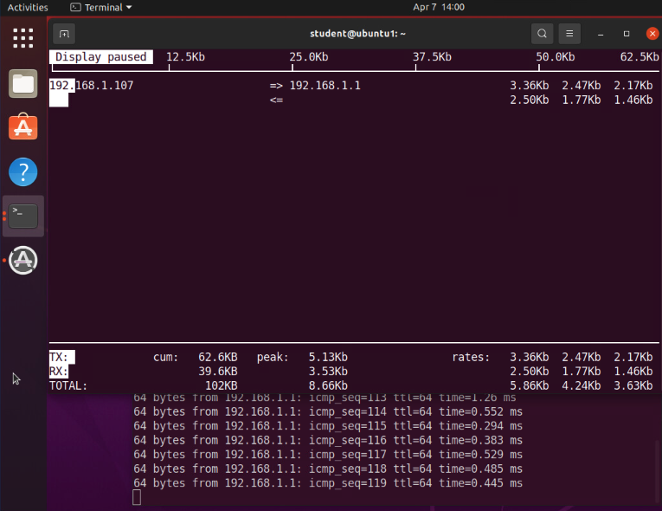
Monitor Network Bandwidth Usage

Slide 23

Wix Link
https://bravoash25.wixsite.com/my-site

